Slide 1
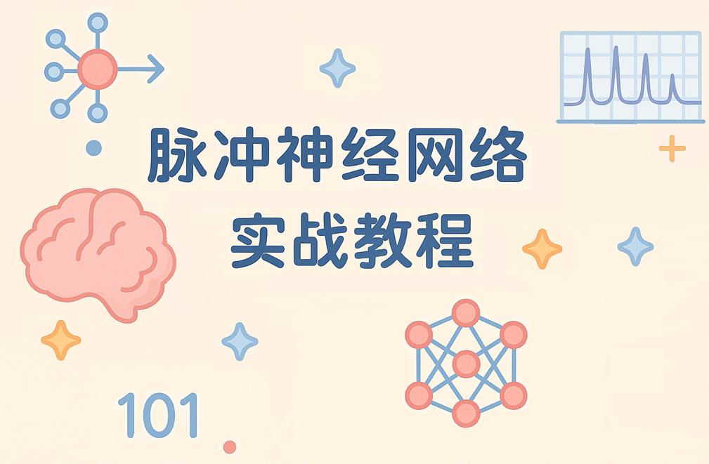
B站/Github：Mouseminar

Slide 2
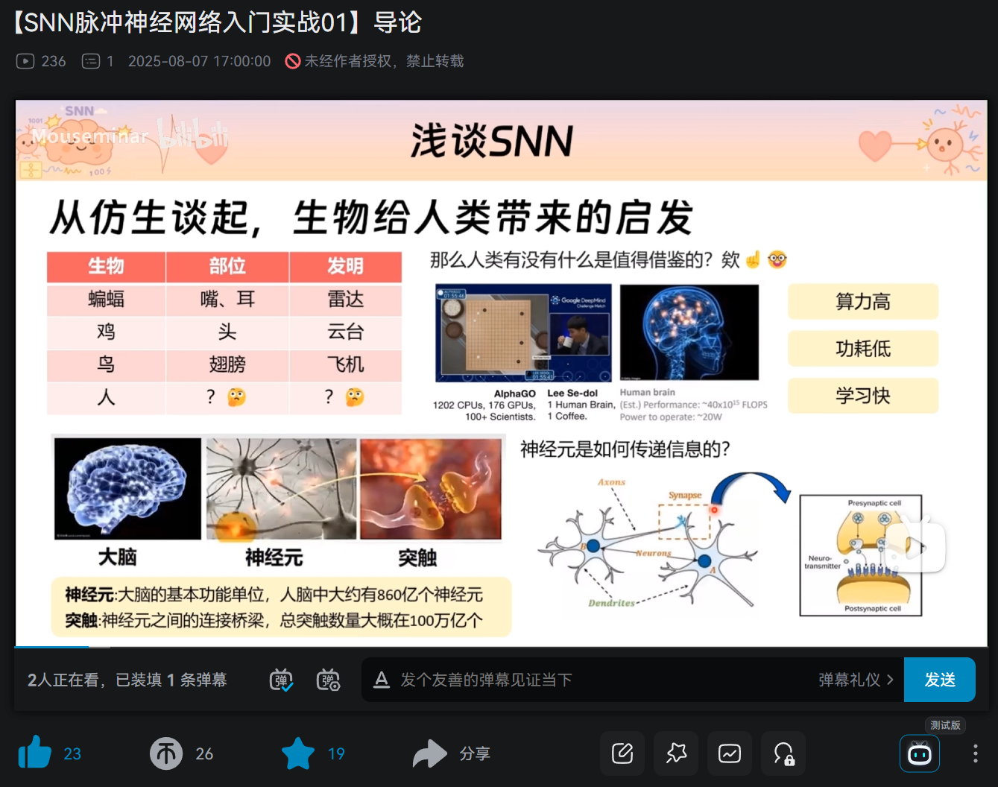
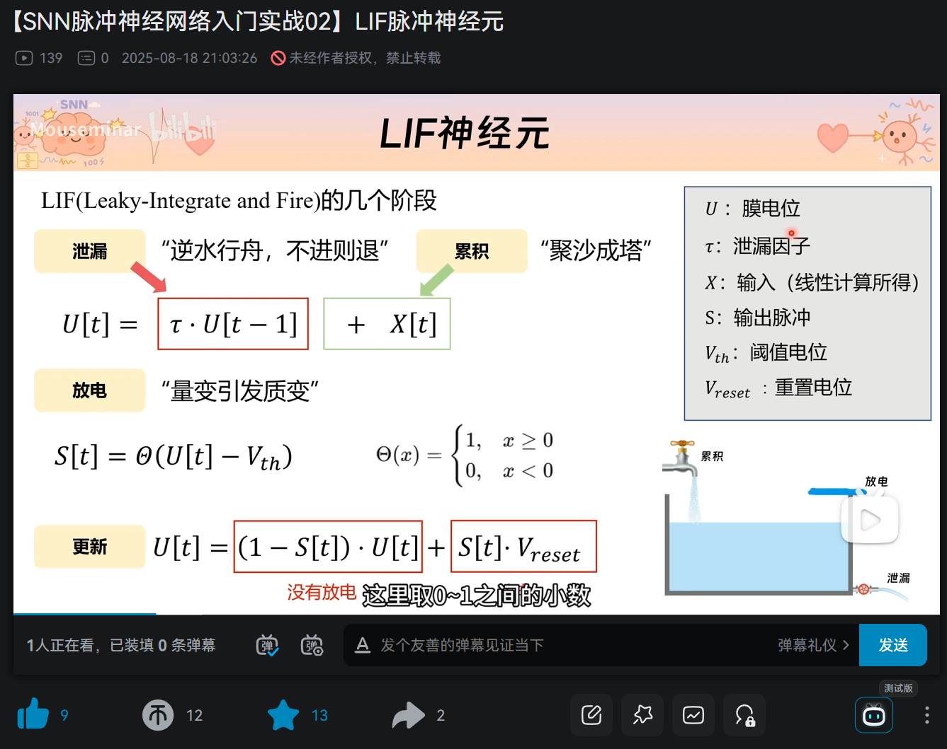
上期视频
【SNN脉冲神经网络入门实战01】导论_哔哩哔哩_bilibili
【SNN脉冲神经网络入门实战02】LIF脉冲神经元_哔哩哔哩_bilibili

Slide 3
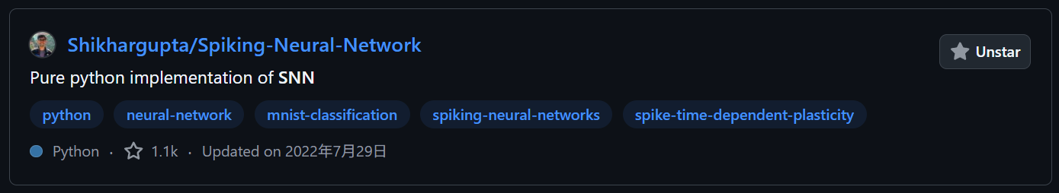
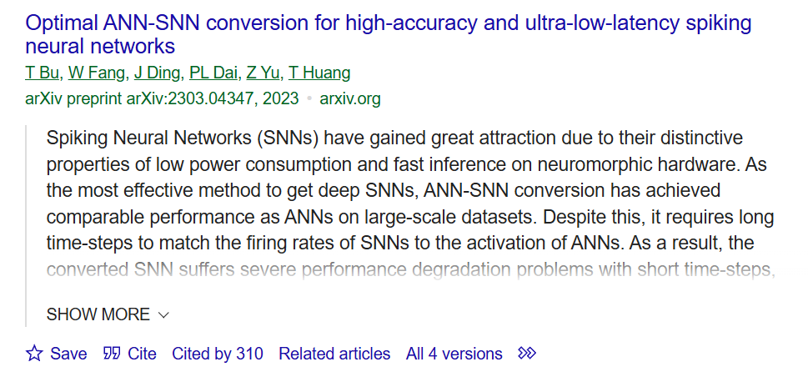
SNN训练
1. 基于STDP的无监督学习
Shikhargupta/Spiking-Neural-Network: Pure python implementation of SNN
2. ANN转SNN
ANN转换SNN — spikingjelly alpha 文档
putshua/SNN_conversion_QCFS
3. 直接训练
使用单层全连接SNN识别MNIST — spikingjelly alpha 文档

Slide 4
直接训练SNN
bollossom/GAC: Offical implementation of "Gated Attention Coding for Training High-performance and Efficient Spiking Neural Networks" (AAAI2024)
先不细讲原理，直接上手
搭建一个能用的ANN网络，然后把它改成SNN
将模型的激活函数替换成LIF神经元，Linear用tdLayer包装
扩充输入的数据维度，增加维度T
输出维度取mean
Layers.py 简洁，好用！😋👍
self.act = LIFSpike(thresh=thresh, tau=tau, gama=gama)
self.fc1_s = tdLayer(self.fc1)
x = add_dimention(x, self.T)
x = x.mean(1)

